Slide 1
THE DATA MINE: Corporate Partners
2025-26 Facilitation Guide | A 3-week side deck to kickstart your collaboration

Slide 2
Sprint 0: Team Meeting
Let’s get acquainted (people + project)
Week 1 | Sprint 0 (Aug 25 - 29)

Slide 3

First Team Meeting Agenda
Welcome aboard!
5min - Wait for students to arrive as it’s the first day of class
Try to be 1 or 2 minutes early in the future
10min – Student introductions (led by TA)
5min – Mentor introductions
20min – Introduce problem (led by Mentor)
5min – Tasking (“Meet the team” slide, other pre-reading resources, etc.)
5min – Open for questions

Slide 4

Student Introductions
Name
Major
Hometown
Pick one:
What made you interested in this project?
Interesting (personal) fact
Favorite summer memory

Slide 5

Meet the Team
Add your slide to the file in our MSTeams
Headshot
Intro
Name
Major
Graduation Year
Hometown
Hobbies/Interests
Why you chose this project

Slide 6
Student (Preferred) Name
Headshot
Hometown
Why did you select this project?
What are you excited to learn more about?
Hobbies/Interests
Major
Graduation Year (and term)
Notes:
Meet the team template

Slide 7
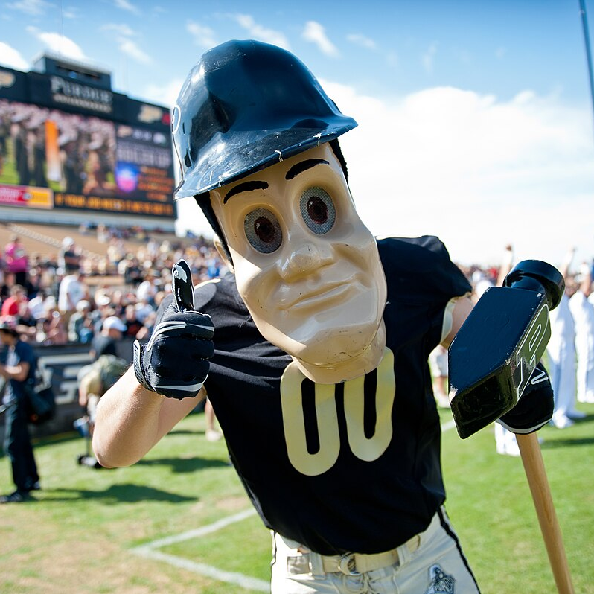
Purdue Pete 🔨
Lafayette, Indiana, USA
Excited to learn about data science and how this company makes use of GitHub & Python. I picked this project due to my interest in Boilermaker Grit.
I enjoy attending Purdue Boiler Gold Rush and visiting the Purdue bookstore. I am a member of many student organizations.
Mascot Studies
Spring 2027

Slide 8
Mentor Introduction(s)

Slide 9
Problem/Project Introduction

Slide 10
Tasking
Verify access to MSTeams team
Create your “Meet the Team” slide and add it to our shared file in MSTeams
Look into learning resources provide by the Mentor
Reminder to complete class assignments, all due dates are posted in the Syllabus

Slide 11
Questions? Comments? Concerns? Complements?

Slide 12
Sprint 0: Lab
LEGO Agile Lab!
Week 1 | Sprint 0 (Aug 25 - 29)

Slide 13
First Lab Agenda
LEGO AGILE LAB (wooooot)
5min – 4 (best) corners warm-up
10min - Introductions, project/company information and logistics
10min - Lego Agile activity instructions and set up
60min - Lego Agile activity
10min - Presentation of final product
10min - Tear down and clean up
5min – Team Intro Survey

Slide 14
Warm-Up: 4 (best) Corners
The room will be divided into four quadrants, which is assigned a preference. A question is asked and students will move to the corner they most align with.

Slide 15
DOG | CAT
FISH | BIRD
Screen
Best household pet
🐶😺🐠🐧

Slide 16




Favorite Superhero

Slide 17
VANILLA | CHOCOLATE
OREO | COOKIE DOUGH
Best ice cream flavor 🍦🍨🥶❄️

Slide 18

How would a dog wear pants?

Slide 19
PIZZA | TACOS
PASTA | BURGER
One food item must be eliminated...

Slide 20
NDAs
The Data Mine is incredibly fortunate to work with our many corporate partners. A large reason we can coordinate these projects is because of the trustworthiness of our students. We place large amounts of trust in you to protect and secure all private company information.
Some companies will require a signed Non-Discloser Agreement (NDA) from all students. If your company assignment requires an NDA, you will receive the NDA to electronically sign (DocuSign) in your email. The NDA must be signed and submitted before you can access any confidential information from the company. If you choose not to sign the NDA for any reason, you will be transitioned to a new team that does not have an NDA requirement.
Some companies will also include an Intellectual Property (IP) Clause or a separate IP Agreement. If you choose not to sign the IP Agreement for any reason, you will be transitioned to a new team that does not have an IP Agreement requirement.
There may be legal consequences in the situation an NDA is violated.
The legal agreements are between you, as an individual, and your corporate partner. Therefore, Purdue and The Data Mine cannot provide legal counsel on these documents.
Thank you for your commitment to the security and confidentiality of our corporate partners’ information!

Slide 21
Agile Crash Course

Slide 22
Customer is actively involved in planning and prioritizing work and provides frequent feedback
Agile is a method of customer-focused project management focused on incremental and iterative delivery
Instead of just delivering a final product all at once there is a regular cadence of feature delivery
What is agile?

Slide 23





Role in Agile
In The Data Mine
Product owner: (Mentor)
Represents the customer
Develops and prioritizes user stories (features the customer wants in the product)
Accepts and rejects work
Scrum Master: (TA)
Organizes work on the development team
Ensures communication between roles
Removes bureaucratic barriers
Developers: (Students)
Responsible for delivering features
Work cross-functionally with other members of the development team

Slide 24
Sprint Cycles
Sprint Planning
Work with PO to determine work to be accomplished during the upcoming sprint
Sprint
Work time to deliver on the features identified during planning
Sprint Review
Present work accomplished during the sprint to the PO and get feedback
Retrospective
Review backlog
Review how the sprint went and how things can be improved in the future
* All Data Mine Corporate Partner projects will utilize an Agile framework this year; grades will be primarily based on your performance during sprints

Slide 25
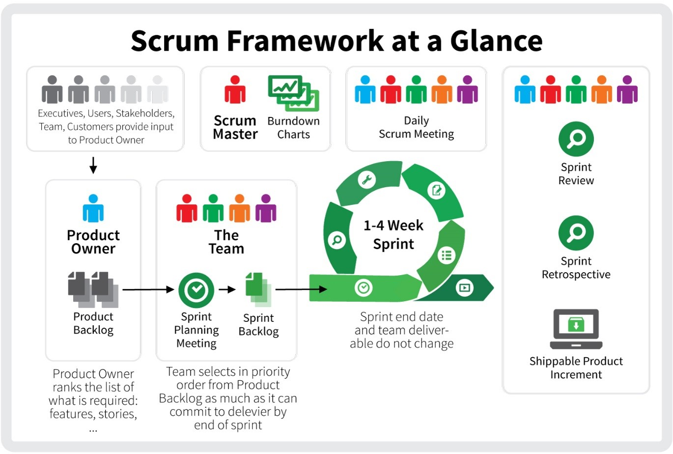

Slide 26
LEGO Agile Activity

Slide 27
TASK: DESIGN AND BUILD A NEW BUILDING FOR THE DATA MINE

Slide 28
Instructions
Teams
Unless otherwise instructed, split your team evenly into 2 groups
3-9 people per group
Each sub team should have a Lego set and project board.
Roles
Your TA will act as the product owner for this activity.
All team members will act as developers.

Slide 29
Instructions
(continued)
Product owners have developed a backlog of tasks. Your sub team will be responsible for allocating work in an Agile methodology and executing the tasks.
However, there are a few caveats…
Your team will need to identify and deliver the minimum viable product (MVP)
You will need to work with the product owner to clarify requests tasks in the backlog.
You may not be able to complete all of the tasks on the backlog with the time and materials provided (you will need to negotiate with the PO!).
Remember, product owners can also change their minds – you may need to be flexible if you build something and they don’t like it.
Creativity is encouraged! A Lego can represent anything as long as it is explained (and communication is a key part of Agile!)

Slide 30
Sprint Timeline
https://www.timeanddate.com/timer/
Sprint Planning (4 minutes)
Choosing what tasks to do during the sprint, estimating time/distributing work, and working with the product owner to clarify tasks.
Use sticky notes to add your initials to the card(s) you will own for the current sprint
Sprint (8 minutes)
Work time in which the product owner is not actively working with you.
Sprint Review (3 minutes)
Present work from the sprint to the product owner and get feedback.
Retrospective (2 minutes)
Discuss what went right, what went wrong, and how you can fix issues in the next sprint (e.g., how you collaborate, estimating time required for tasks, etc.)
Repeat! (3x)

Slide 31
Team Introduction Survey
https://the-examples-book.com/crp/TAs/trainingModules/ta_training_module5_11_survey

Slide 32
Sprint 1: Team Meeting
Meet the Team
Week 2 | Sprint 1 (Sep 01 - 12)

Slide 33
Team Meeting Agenda
Week 2
10min – Updates from Mentors
35min – Updates from Students
5min – Open Questions

Slide 34
Questions? Comments? Concerns? Complements?

Slide 35
Sprint 1: Lab
How to work together as a team
Week 2 | Sprint 1 (Sep 01 - 12)

Slide 36
Lab Agenda
Week 2
25min – Agile Reflection
5min – Kanban Boards
10min – RACI Matrix
5min – Tuckman’s Model
3min – Brain Break
2min – Team Values Intro
50min – Project Work Time
5min – Open Questions

Slide 37
Agile Reflection

Slide 38

Sprint Kahoot Review
https://create.kahoot.it/share/tdm-agile-review/2d89128e-9e57-4d18-8f67-4e8b703d7493

Slide 39
Sprint Retrospective
Should take 5-8 minutes total
What went well during Sprint #0? (Lego Activity, Team Meetings)
What didn’t go well during Sprint #0? (Lego Activity, Team Meetings)
How can we improve Sprint #1?
What are some questions you have regarding Spring #0?

Slide 40
Stand-Up
Less then 60 seconds per person
What have you been working on since the last meeting?
What are you currently working on?
Are there any blockers or barriers preventing you from doing your work?

Slide 41
Sprint Planning
What are some task we want to focus on completing this sprint?
Who will work on these task(s)?
What will the final product of this task look like?
→ Update the task-cards on the MSTeams Kanban board

Slide 42
Helpful Resources
GitHub on Anvil:
https://the-examples-book.com/starter-guides/tools-and-standards/git/github-anvil
Starter guides:
https://the-examples-book.com/starter-guides/introduction
Purdue literature review guide:
https://guides.lib.purdue.edu/research_approaches/litreview

Slide 43
Kanban Boards

Slide 44
Kanban Boards
Intro/Overview
Visual tool for project management.
Helps visualize work and limit work-in-progress.
Maximizes efficiency in Agile methodologies.
Product Backlog
Everything you could ever work on that you haven’t yet.
Place to put ideas mid-sprint before Sprint Planning.
Items can be broken down and prioritized.

Slide 45
Kanban Boards
Sprint Backlog
Subset of the Product Backlog.
Tasks committed for a specific sprint (2 weeks in TDM).
Guides team’s work during the sprint.
In-Progress
Represents tasks being worked on (active development).
Keeps team aware of task status.
Ownership assigned.

Slide 46
Kanban Boards
Review
Tasks completed but awaiting review (by Mentor).
Ensures work meets required standards.
Essential for quality control.
Done
Represents completed and approved tasks.
No further action required.

Slide 47
RACI Matrix
🌠 Now entering the responsibility dimension 🌠

Slide 48
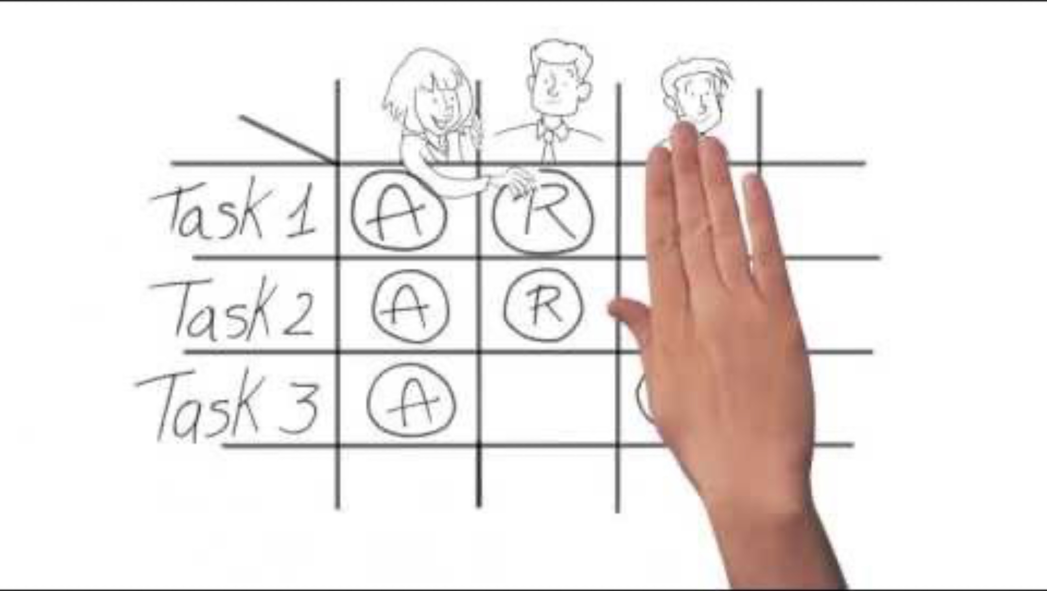
RACI explained
Video

Slide 49
What’s a “RACI”
https://the-examples-book.com/crp/students/raci_guide
Responsible: The person or group responsible for completing a specific task or deliverable. They are responsible for doing the work.
Accountable: This role delegates, reviews, and ensure the project meets expectations and deadlines. This person responsible for the task’s success or failure. There should be only one "Accountable" person assigned to each task..
Consulted: Individuals or groups that need to be consulted for their expertise, input, or feedback during the task’s execution. These stakeholders are not directly responsible for the task but may offer valuable insights.
Subject Matter Experts (SMEs), Faculty Mentors, TAs
Informed: Individuals or groups that need to be informed about the progress or results of the task but don’t need to be actively involved in its execution.
Corporate Mentors

Slide 50
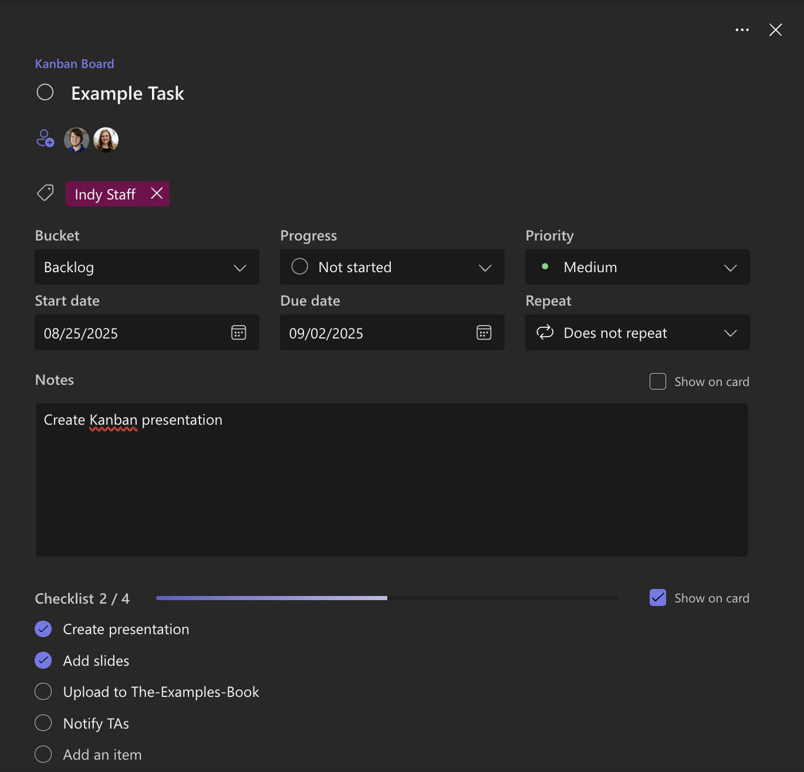
How do we track this?
RACI in The Data Mine
This is what a task card looks like in MSTeams Planner
A successful task-card has:
Task Name
People Assigned (includes both responsible and accountable people)
Correct Tags/Flags
Due Date (when should it be completed)
Notes (more details about the task)
Checklist (how do we know were are done)

Slide 51
Tuckman’s Team Development Model

Slide 52
Team Stages
Tuckman’s Team Development Model
Forming
Storming
Norming
Performing
Adjourning

Slide 53
Forming
Team members are polite, positive, and a bit uncertain as they get to know each other.
Roles and responsibilities are unclear; people look to a leader for guidance.
This is a time for building trust and setting initial goals.

Slide 54
Storming
Conflicts may arise as personalities clash and ideas compete.
Team members challenge boundaries, roles, and leadership.
It's a critical phase for learning how to handle disagreements constructively.

Slide 55
Norming
The team begins to settle into roles and establish shared norms.
Collaboration improves as trust and respect grow.
Members start to support each other and focus on common goals.

Slide 56
Performing
The team works efficiently toward goals with high trust and autonomy.
Roles are clear, and members are motivated and competent.
Problem-solving and decision-making are collaborative and effective.

Slide 57
Performing
The team completes its tasks and prepares to disband.
Members reflect on achievements and say goodbye.
This stage can be emotional, especially if the team bonded well.

Slide 58
Brain Break
We just learned a lot! Switch seats, stand up, or stretch to keep your brain alert.

Slide 59
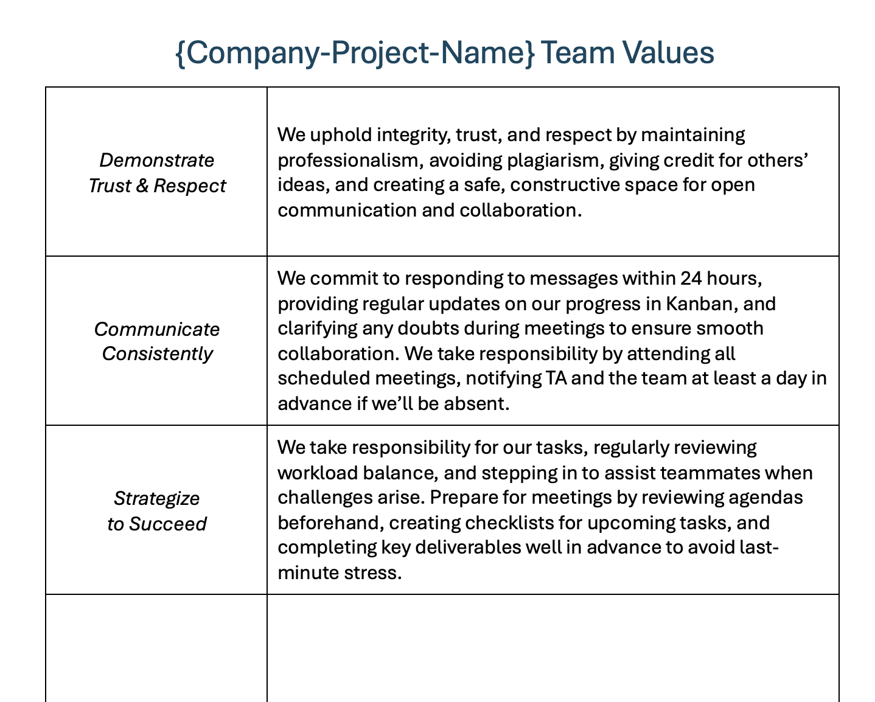
Team Values
Review the “Team Values” document in MSTeams, bring an idea of a value we can add during next week’s Lab

Slide 60
Project Work Time

Slide 61
Questions? Comments? Concerns? Complements?

Slide 62
Sprint 1: Team Meeting
Taking care of business
Week 3 | Sprint 1 (Sep 01 - 12)

Slide 63
Team Meeting Agenda
Let’s get this project started!

Slide 64
Questions? Comments? Concerns? Complements?

Slide 65
Sprint 1: Lab
Team Values + Work Time
Week 3 | Sprint 1 (Sep 01 - 12)

Slide 66
Team Meeting Agenda
Let’s prepare to work together!
15min – Warm-Up
25min – Team Values
65min – Work time
5min – Open Questions

Slide 67
Warm-up: Wads of Truth
Identify facts about each other after a thrilling snowball fight
Cut sheets of paper into quarters
Give each student two quarters
Students write a unique truthful statement / fun fact about themselves on each quarter (do not include name)
The quarter is then crumpled into a ball-like shape
The wads are then tossed around, like a snowball fight
Each student collects two wads
Student take turns opening a single wad, reading the fact aloud, then attempt to figure out who wrote it

Slide 68
Team Values
Your TA will lead this activity by:
Downloading this Team Values template
Work as a team to add three more values
TA will upload this to Gradescope on behalf of the entire team

Slide 69
Questions? Comments? Concerns? Complements?

